Slide 1



Shramik Sevan
Shramik Sevan provides a working platform for labours. and builds transparency between labours and contractors
Rahul Sagar , Nitesh Kumar, Kuldeep
Shradha Shree , Aishna

Slide 2
Content
About [Shramik Sevan]
Problem Statement
Empathy Map
Research
Our Solution
Market Opportunity
Revenue Model
Competitive Advantages
Government Compliance
Roadmap
Who We Are, Our Mission, Our Vision, Key Features.
Origin of problem,understand problem, Business Scope.
Empathy Map for Laborers and Customers.
Study Government (Roles, Raglan and Services.), Employment Unemployment Rate.
Shramik Sevan platform.
Market Size, Target Audience.
Four Standard Types of Revenue Model.
Many Types of Competitive Advantages.
Brief Explain Compliance and Lows.
Tell About Future Planning Steps.
Rahul Sagar , Nitesh Kumar , Kuldeep
Shradha Shree , Aishna

Slide 3


About
Who We Are:
Shramik Sevan is a revolutionary platform that connects customers directly with skilled and unskilled labourers.
Our Mission:
Rahul Sagar , Nitesh Kumar, Kuldeep
Shradha Shree , Aishna
To empower the labour force by providing a fair and transparent working platform.
Our Vision
To be the leading platform ensuring accessibility, equality, and empowerment for all labourers.
Key Features
For Customers:
For Labourers:
Easy labour search and hiring
Process.Verified and skilled labourers.
Transparent pricing and secure payment options.
  Equal work opportunities.
  Guaranteed fair wages.
  Training and upskilling programs.

Slide 4
Problem Statement
Origin of problem:
Observation started in Rudrapur
Rudrapur
Struggle to find labor for repair/maintenance work.
getting labor under contractor
have to pay higher fees for minor repairs.
Proper platform was not available for labour .
Unavailability of labours
Higher amount have to pay for minor repair work.
Involvement of contactor /middleman
Rahul Sagar , Nitesh Kumar , Abhinav , Kuldeep
Shradha Shree , Aishna
understand problem:
Challenges Customers Face:
Difficulty finding reliable labourers
Lack of transparency in rates.
No accountability or platform to address grievances.
Challenges Labourers Face:
Limited access to work opportunities.
Exploitation and unfair pay.
Lack of platforms ensuring fair treatment.
Business Scope:
This issue is widespread across India , affects the livelihood of many labous.
This market is very fast growing market .

Slide 5


Empathy Map
Laborers:
Customers:
  Thinks:
  Struggles to find labor for small jobs.
  Says:
  Contractors charge high fees.
  Does:
  Forced to hire contractors.
  Feels:
  Frustrated with the high cost and lack of direct access to labor.
  Thinks:
  Cannot express views, lacks family time, no transparency with contractors.
  Says:
  Low payment, hears negative feedback, limited skill development.
  Does:
  Limited learning, dependent on contractors.
  Feels:
  Underappreciated, underpaid, often unemployed.
Rahul Sagar , Nitesh Kumar , Kuldeep
Shradha Shree , Aishna

Slide 6
Research
LFPR in Uttarakhand: Overall 65.9%Men: 65.9%Women: 34.09%This highlights the gender disparity in workforce participation, with a need for more initiatives to encourage female participation.
Unemployment Rate: As of March 2023, the unemployment rate in Uttarakhand is 0.85%. This low rate indicates relatively high employment but does not account for underemployment or informal sector challenges.
Rahul Sagar , Nitesh Kumar, Kuldeep
Shradha Shree , Aishna
Skill Training: Only 5% of India’s labor force has formal training. This low percentage underscores the urgent need for vocational training and skill development programs to enhance workforce capabilities.
Income and Job Security: Many laborers work in informal settings with inconsistent income and lack of job security. This often leads to economic instability and vulnerability.
Education and Awareness: There is a significant lack of awareness about rights and benefits among laborers, leading to exploitation and poor working conditions. Increasing educational initiatives can empower laborers to demand fair treatment and wages.

Slide 7


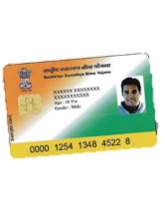
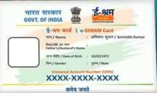
Ministry of Labour & Employment:
  Objective: Safeguarding worker interests, social security, and improved work conditions.
  Key Programs: Job security, fair wages, health benefits.
Welfare Acts:
  Unorganized Workers’ Social Security Act, 2008: Social security and welfare measures for unorganized sector workers.
Rahul Sagar , Nitesh Kumar, Kuldeep
Shradha Shree , Aishna
Government Initiatives:
  Labour Card: Identifies and registers laborers for benefits like financial aid and health insurance.
  E Shram Card: Digital platform providing identity and benefits like insurance, pension, and emergency assistance.

Slide 8





Our Solution
SOLUTION: Empowering Laborers through a User-Friendly App
Direct Contact:
Connects laborers and customers directly.
Provides more work opportunities for laborers.
Rahul Sagar , Nitesh Kumar, Kuldeep
Shradha Shree , Aishna
Empowerment:
Educates laborers about their rights.
Offers skill development resources.
User-Friendly Interface:
Simple and intuitive design.
Accessible for illiterate users.
Transparency:
Clear communication between laborers and customers.
Rating system for trust and reliability.

Slide 9



Additional Features:
  Multilingual support.
  Notifications for job opportunities and updates.
Benefits for Laborers:
  Empowerment through direct negotiation of pay.
  Increased opportunities and better work-life balance.
  Enhanced skill development and recognition in their field.
Benefits for Customers:
  Easy access to reliable labor for small jobs.
  Cost-effective as it eliminates contractor fees.
  Transparent hiring process
Rahul Sagar , Nitesh Kumar, Kuldeep
Shradha Shree , Aishna

Slide 10
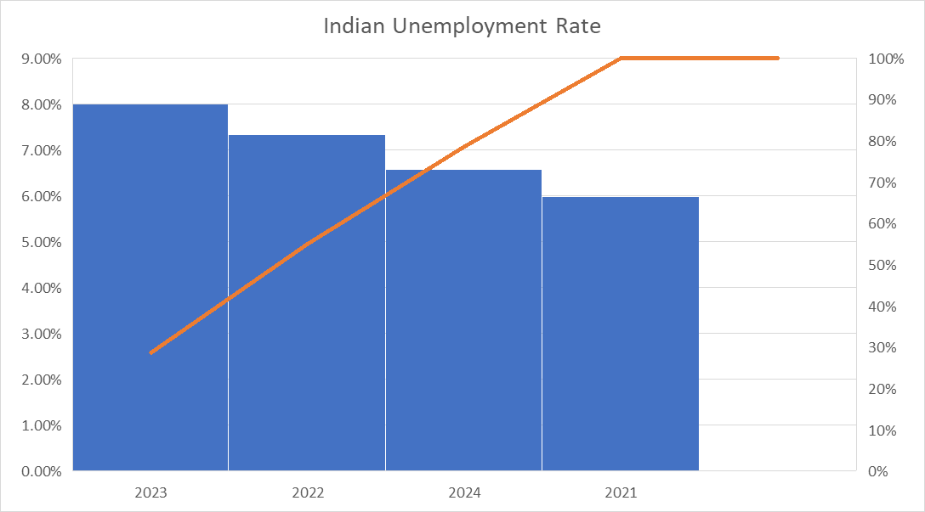
Market Opportunity
India's labor market is vast, with millions of unorganized workers in search of consistent opportunities. The potential lies in:
Urbanization: Rising demand for labor in cities for construction, repairs, domestic work, etc.
Digital Penetration: With increasing smartphone usage, digital platforms are gaining traction.
Customer Needs: Lack of reliable services to find trusted, skilled, and verified laborers.
Government Support: Programs like Skill India align with your platform’s goals, creating synergies.
Rahul Sagar , Nitesh Kumar, Kuldeep
Shradha Shree , Aishna

Slide 11
Revenue Model
Commission: A small fee per transaction from customers .
One time Registration fees: labour pay small amount registration fee 10 to 50[only for one time pay].
Subscription Plans: Premium listings or priority hiring for customers.
Ads and Sponsorships: Local businesses or training institutes promoting services.
Training and Upskilling: Paid courses for laborers to enhance skills.
Rahul Sagar , Nitesh Kumar, Kuldeep
Shradha Shree , Aishna
Revenue model

Slide 12
Competitive Advantages
100% transparency between labourers and customers.
Compliance with government rules and regulations.
Verified profiles ensuring trust and reliability.
Streamlined processes for bookings, payments, and feedback.
Focus on labour empowerment through upskilling and fair wages.
Customizable services to meet specific customer needs.
Dedicated grievance redressal mechanism for both customers and labourers.
Data-driven insights for workforce planning and optimization.
Multi-language support to cater to diverse regional users in India.
Mobile-friendly platform for easy access in remote areas.
Support for short-term and long-term hiring needs, ensuring flexibility.
Rahul Sagar , Nitesh Kumar, Kuldeep
Shradha Shree , Aishna

Slide 13

Government Compliance
Labour Law Adherence: Ensures strict compliance with all Indian labour laws, including minimum wage regulations and working conditions.
Fair Wages: Guarantees payment of fair wages to labourers as per government norms.
Ethical Treatment: Promotes ethical treatment of workers by setting clear guidelines and terms.
Employment Generation: Aligns with government policies to create employment opportunities for underprivileged sectors.
Skill Development: Collaborates with government training programs like Skill India to enhance labourers' capabilities.
Tax and Documentation: Ensures proper tax filings and documentation for all transactions on the platform.
Social Security Benefits: Educates and facilitates access to social security schemes like EPF, ESIC, and insurance benefits for labourers.
Grievance Redressal: Provides a robust mechanism to handle disputes and complaints, ensuring accountability for both customers and labourers.
Rahul Sagar , Nitesh Kumar, Kuldeep
Shradha Shree , Aishna

Slide 14
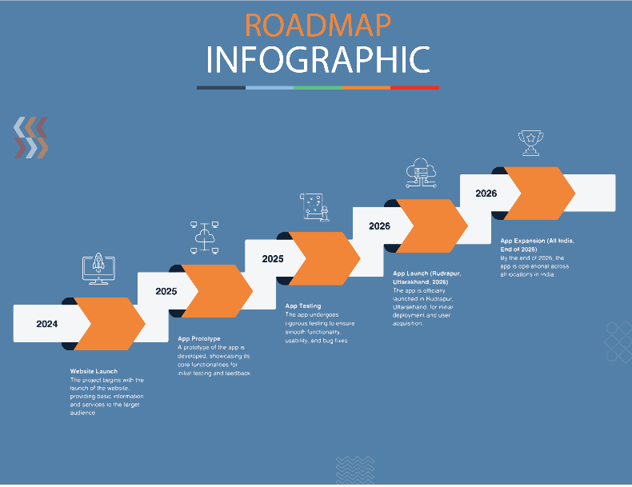
Rahul Sagar , Nitesh Kumar , Kuldeep
Shradha Shree , Aishna

Slide 15


THANKS!
DO YOU HAVE ANY QUESTIONS?
shramiksevan@gmail.com
91+8869027382
www.shramiksevan.com

